Slide 1
Introduction to Inferential Statistics
Probability Basics
Probability Distributions
Random Variables
Expected Value

Slide 2
Statistics
An Introduction and Overview

Slide 3
Statistics
We use statistics for many reasons:
  To mathematically describe/depict our findings
  To draw conclusions from our results
  To test hypotheses
  To test for relationships among variables

Slide 4
Statistics
Numerical representations of our data
Can be:
  Descriptive statistics summarize data.
  Inferential statistics are tools that indicate how much confidence we can have when we generalize from a sample to a population.

Slide 5
Statistics
Powerful tools… we must use them for good.
  Be sure our data is valid and reliable
  Be sure we have the right type of data
  Be sure statistical tests are applied appropriately
  Be sure the results are interpreted correctly
  Remember… numbers may not lie, but people can

Slide 6
Sampling & Statistics
Statistics depend on our sampling methods:
Probability or Non-probability? (i.e. Random or not?)

Slide 7
Probability Samples
Even with probability samples, there is a possibility that the statistics we obtain do not accurately reflect the population.
Sampling Error
  Inadequate sampling frame, low response rate, coverage (some people in population not given a chance of selection)
Non-Sampling Error
  Problems with transcribing and coding data; observer/ instrument error; misrepresenation as error.

Slide 8
Measurement
Levels of Measurement – the relationship among the values that are assigned to a variable and the attributes of that variable.

Slide 9
Levels of Measurement
Nominal- naming
Ordinal- rank order (high to low but no indication of how much higher or lower one subject is to another)
Interval- equal intervals between values
Ratio- equal intervals AND an absolute zero (i.e. a ruler)

Slide 10
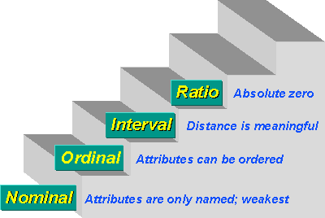
Levels of Measurement

Slide 11
Levels of Measurement: Identify
Age: under 30, 30-39, 40-49, 50-59
Gender: Male, Female
Level of Agreement: Strongly Agree, Agree, Neutral, Disagree, Strongly Disagree
Percentage of the library budget spent on staff salaries.

Slide 12
Statistics: What’s What?
Descriptive objectives/ research questions:
  Descriptive statistics
Comparative objectives/ hypotheses
  Inferential Statistics

Slide 13
Descriptive Statistics
Can be applied to any measurements (quantitative or qualitative)
Offers a summary/ overview/ description of data. Does not explain or interpret.

Slide 14
Descriptive Statistics
Number
Frequency Count
Percentage
Deciles and quartiles
Measures of Central Tendency (Mean, Midpoint, Mode)
Variability
Variance and standard deviation
Graphs
Normal Curve

Slide 15
Means of Central Tendency
Averages
  Mode: most frequently occurring value in a distribution (any scale, most unstable)
  Median: midpoint in the distribution below which half of the cases reside (ordinal and above)
  Mean: arithmetic average- the sum of all values in a distribution divided by the number of cases (interval or ratio)

Slide 16
Median (Mid-point)
Example (11 test scores)
61, 61, 72, 77, 80, 81, 82, 85, 89, 90, 92
The median is 81 (half of the scores fall above 81, and half below)

Slide 17
Median (Mid-point)
Example (6 scores)
3, 3, 7, 10, 12, 15
Even number of scores= Median is half-way between these scores
Sum the middle scores (7+10=17) and divide by 2
17/2= 8.5

Slide 18
Median
Insensitive to extremes
3, 3, 7, 10, 12, 15, 200

Slide 19
Mean: Arithmetic Average
Mean is half the sum of a set of values:
Scores: 5, 6, 7, 10, 12, 15
Sum: 55
Number of scores: 6
Computation of Mean: 55/6= 9.17

Slide 20
Mean
Influenced by extremes
Only appropriate with interval or ration data
Is this four-point scale ordinal or interval?
1= Strongly Agree 3=Disagree
2=Agree 4=Strongly Disagree

Slide 21
Mode: Frequency
Mode is the most frequently occurring value in a set.
Best used for nominal data.

Slide 22
Shapes of Distribution
Normal Curve (aka Bell Curve)
Repeated sampling of a population should result in a “normal” distribution- clustering of values around a central tendency.
In a symmetrical distribution, median, mode and mean all fall at the same point

Slide 23
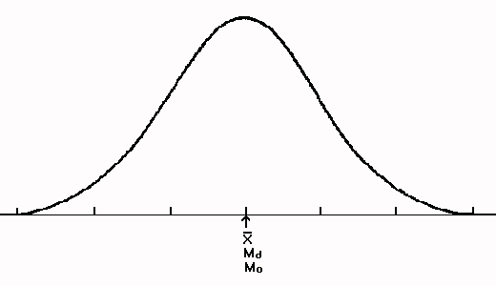
Normal Curve

Slide 24
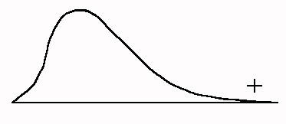
Distribution: Skewness
Skewed to the right (positive) or left (negative)
An extremely hard test that results in a lot of low grades will be skewed to the right:

Slide 25
Positive
the mode is smaller than the median, which is smaller than the mean. This relationship exists because the mode is the point on the x-axis corresponding to the highest point, that is the score with greatest value, or frequency. The median is the point on the x-axis that cuts the distribution in half, such that 50% of the area falls on each side.

Slide 26
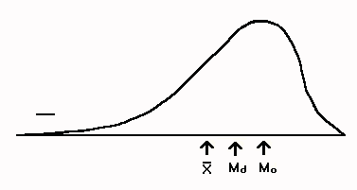
Negative
An extremely easy test will result in a lot of high grades, and will skew to the left (negative)

Slide 27
Negative
The order of the measures of central tendency would be the opposite of the positively skewed distribution, with the mean being smaller than the median, which is smaller than the mode.

Slide 28
Variability
Variability is the differences among scores- shows how subjects vary:
  Dispersion: extent of scatter around the “average”
  Range: highest and lowest scores in a distribution
  Variance and standard deviation: spread of scores in a distribution. The greater the scatter, the larger the variance
Interval or ration level data
Standard deviation: how much subjects differ from the mean of their group

Slide 29
Standard Deviation
Measures how much subjects differ from the mean of their group
The more spread out the subjects are around the mean, the larger the standard deviation
Sensitive to extremes or “outliers”

Slide 30
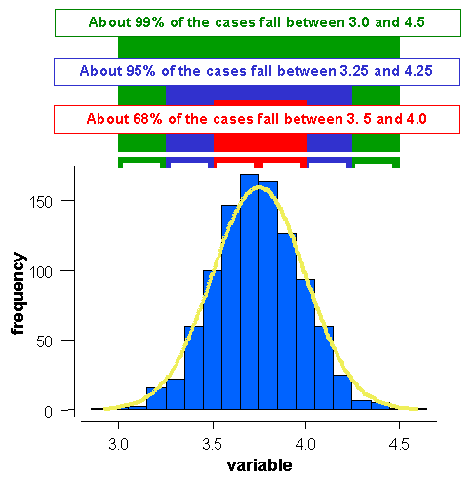
Standard Deviation: 66, 95, 99%

Slide 31
Inferential Statistics
Allows for comparisons across variables
  i.e. is there a relation between one’s occupation and their reason for using the public library?
Hypothesis Testing

Slide 32
Levels of significance
The level of significance is the predetermined level at which a null hypothesis is not supported. The most common level is p < .05
  P =probability
  < = less than (> = more than)

Slide 33
Error Type
Type I error
  Reject the null hypothesis when it is really true
Type II error
  Fail to reject the null hypothesis when it is really false

Slide 34
Probability
By using inferential statistics to make decisions, we can report the probability that we have made a Type I error (indicated by the p value we report)
By reporting the p value, we alert readers to the odds that we were incorrect when we decided to reject the null hypothesis

Slide 35
Particular Tests
Chi-square test of independence: two variables (nominal and nominal, nominal and ordinal, or ordinal and ordinal)
  Affected by number of cells, number of cases
  2-tailed distribution= null hypothesis
  1-tailed distribution= directional hypothesis
  Cramer’s V, Phi
        example

Slide 36
Inferential Statistics (2)
Correlation—the extent to which two variables are related across a group of subjects
  Pearson r
    It can range from -1.00 to 1.00
    -1.00 is a perfect inverse relationship—the strongest possible inverse relationship
    0.00 indicates the complete absence of a relationship
    1.00 is a perfect positive relationship—the strongest possible direct relationship
    The closer a value is to 0.00, the weaker the relationship
    The closer a value is to -1.00 or +1.00, the stronger it is
  Spearman rho

Slide 37
More tests
t-test
  Test the difference between two sample means for significance
  pretest to posttest
  Relates to research design
  Perhaps used for information literacy instruction
Analysis of variance
Regression analysis (including step-wise regression)

Slide 38
More tests
Analysis of variance (ANOVA) tests the difference(s) among two or more means
It can be used to test the difference between two means
So use t-test or ANOVA?
KEY: ANOVA also can be used to test the difference among more than two means in a single test—which cannot be done with a t test

Slide 39
More tests
While correlation and regression both indicate association between variables, correlation studies assess the strength of that association
Regression analysis, which examines the association from a different perspective, yields an equation that uses one variable to explain the variation in another variable.
Regression is used to predict the value of one variable by knowing the value of another variable

Slide 40
YUP, more tests
Multiple regression examines the relationship between a dependent variable (changes in response to the change the researcher makes to the independent variable) and two or more independent variables (manipulated variables)
Stepwise multiple regression predicts the value of a dependent variable using independent variables, and it also examines the influence, or relative importance, of each independent variable on the dependent variable

Slide 41
NOTE
Remember impact of memory on responding
  Norman M. Bradburn, Lance J. Rips, and Steven K. Shevell, “Answering Autobiographical Questions: The Impact of Memory and Inference on Surveys,” Science 236 (April 10, 1987): 157-161

Slide 42
Parametric and Nonparametric statistics
Parametric statistical tests generally require interval or ratio level data and assume that the scores were drawn from a normally distributed population or that both sets of scores were drawn from populations with the same variance or spread of scores
Nonparametric methods do not make assumptions about the shape of the population distribution. These are typically less powerful and often need large samples

Slide 43
Selecting an Appropriate Statistical Test
The appropriate measurement scale(s) to use
Is intent to characterize respondents (descriptive statistics) or draw inferences to population (inferential statistics)
The level of significance used and focusing on one- or two-tailed distribution
Whether the mean or median better characterize the dataset
Whether the population is normal
The number of independent (experimental or predicator variables that evaluators manipulate and that presumably change) and dependent (influenced by the independent variable(s))
Uses parametric or nonparametric statistics
Willing to risk a type I or type II errors
  I: possibility of rejecting a true null hypothesis
  II: possibility of accepting the null hypothesis when it is false

Slide 44
Depicting Data
Making it Comprehesnible

Slide 45
Population and Population Centers by State: 2000
How depict the data
  http://www.census.gov/geo/www/cenpop/statecenters.txt

Slide 46
Graphs
Their purpose
Some types: Bar charts, pie charts, area charts, line charts
http://www.statcan.ca/english/edu/power/ch9/piecharts/pie.htm

Slide 47
Journey to Work From Census 2000
Among the 128.3 million workers in the United States in 2000,
76 % drove alone to work
12 % carpooled
4.7 % used public transportation
3.3 % worked at home
2.9 % walked to work
1.2 % used other means (including motorcycle or bicycle)
http://www.census.gov/prod/2004pubs/c2kbr-33.pdf

Slide 48
Examples
Alumni Satisfaction Survey
    Recode
Library Services Assessment Clearinghouse
  http://www.hollins.edu/academics/library/lsac.htm
  Library Surveys & Questionnaires
  http://web.syr.edu/~jryan/infopro/survey.html
  Performance Measures
  http://equinox.dcu.ie/reports/pilist.html

Slide 49
Inferential Statistics
Testing for Differences

Slide 50
Introduction
Whether the research design is experimental, quasi-experimental, or non-experimental, many researchers develop their studies to look for differences
  they look for differences between or among the group or categories of the IV in relationship to the DV

Slide 51
Inferential Statistics
Inferential statistics are used to draw conclusions about a population by examining the sample
POPULATION
Sample

Slide 52
Inferential Statistics
Accuracy of inference depends on representativeness of sample from population
random selection
  equal chance for anyone to be selected makes sample more representative

Slide 53
Inferential Statistics
Inferential statistics help researchers test hypotheses and answer research questions, and derive meaning from the results
  a result found to be statistically significant by testing the sample is assumed to also hold for the population from which the sample was drawn
  the ability to make such an inference is based on the principle of probability

Slide 54
Inferential Statistics
Researchers set the significance level for each statistical test they conduct
  by using probability theory as a basis for their tests, researchers can assess how likely it is that the difference they find is real and not due to chance

Slide 55
Alternative and Null Hypotheses
Inferential statistics test the likelihood that the alternative (research) hypothesis (H₁) is true and the null hypothesis (H₀) is not
  in testing differences, the H₁ would predict that differences would be found, while the H₀ would predict no differences
  by setting the significance level (generally at .05), the researcher has a criterion for making this decision

Slide 56
Alternative and Null Hypotheses
If the .05 level is achieved (p is equal to or less than .05), then a researcher rejects the H₀ and accepts the H₁
If the the .05 significance level is not achieved, then the H₀ is retained

Slide 57
Degrees of Freedom
Degrees of freedom (df) are the way in which the scientific tradition accounts for variation due to error
  it specifies how many values vary within a statistical test
    scientists recognize that collecting data can never be error-free
    each piece of data collected can vary, or carry error that we cannot account for
    by including df in statistical computations, scientists help account for this error
    there are clear rules for how to calculate df for each statistical test

Slide 58
Inferential Statistics: 5 Steps
To determine if SAMPLE means come from same population, use 5 steps with inferential statistics
  1. State Hypothesis
    H_{o}: no difference between 2 means; any difference found is due to sampling error
      any significant difference found is not a TRUE difference, but CHANCE due to sampling error
    results stated in terms of probability that H_{o} is false
      findings are stronger if can reject H_{o}
      therefore, need to specify H_{o} and H₁

Slide 59
Steps in Inferential Statistics
2. Level of Significance
  Probability that sample means are different enough to reject H_{o} (.05 or .01)
    level of probability or level of confidence

Slide 60
Steps in Inferential Statistics
3. Computing Calculated Value
  Use statistical test to derive some calculated value (e.g., t value or F value)
4. Obtain Critical Value
  a criterion used based on df and alpha level (.05 or .01) is compared to the calculated value to determine if findings are significant and therefore reject H_{o}

Slide 61
Steps in Inferential Statistics
5. Reject or Fail to Reject H_{o}
  CALCULATED value is compared to the CRITICAL value to determine if the difference is significant enough to reject H_{o} at the predetermined level of significance
    If CRITICAL value > CALCULATED value --> fail to reject H_{o}
    If CRITICAL value < CALCULATED value --> reject H_{o}
    If reject H_{o}, only supports H₁; it does not prove H₁

Slide 62
Testing Hypothesis
If reject H_{o} and conclude groups are really different, it doesn’t mean they’re different for the reason you hypothesized
  may be other reason
Since H_{o} testing is based on sample means, not population means, there is a possibility of making an error or wrong decision in rejecting or failing to reject H_{o}
  Type I error
  Type II error

Slide 63
Testing Hypothesis
Type I error -- rejecting H_{o} when it was true (it should have been accepted)
  equal to alpha
  if α = .05, then there’s a 5% chance of Type I error
Type II error -- accepting H_{o} when it should have been rejected
  If increase α, you will decrease the chance of Type II error

Slide 64
Identifying the Appropriate Statistical Test of Difference
One variable
One-way chi-square
Two variables
(1 IV with 2 levels; 1 DV)
t-test
Two variables
(1 IV with 2+ levels; 1 DV)
ANOVA
Three or more variables
ANOVA

Slide 65
Chapter 8: Hypothesis Testing and Inferential Statistics
What are inferential statistics, and how are they used to test
a research hypothesis?
What is the null hypothesis?
What is alpha?
What is the p-value, used in most hypothesis test?
What are Type 1 and Type 2 errors, and what is the relationships
between them
What is beta, and how does beta relate to the power of a statistical
test?
What is the effect size statistic, and how is it used?

Slide 66
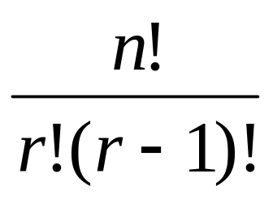
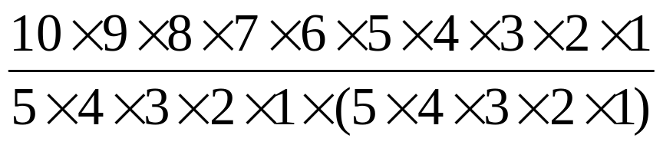
Sampling Distribution
Sampling Distribution
The distribution of all of the
possible values of a statistic.
Example. To examine your friend’s ESP aptitude, you ask your
friend to guess on ten coin flips (heads and tails)
nCr =
2¹⁰ = 1024
₁₀C₅ =
= 252

Slide 67
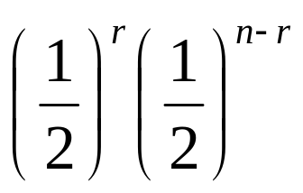
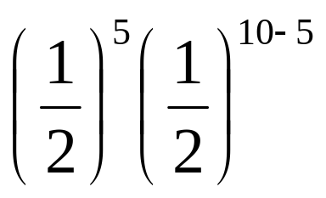
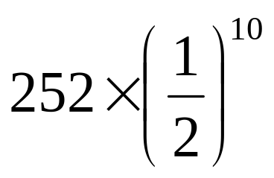

Binomial distribution
See Figure 8.2 on page 132…...
nCr
₁₀C₅
=
=
=
24.6
Task 1. Calculate the other possibilities and their distribution.

Slide 68
The null hypothesis
The assumption in which the variable
A is not statistically differ from the
variable B.
H₀
Example 1. The coin guessing experiment
H₀ is that the probability of a correct guess is chance level ( = .5)
Example 2. A correlational design
H₀ is that there is no correlation between the two measured variables
(r = 0). (the correlation between SAT and College GPA.)
Example 3. An experimental design
H₀ is that the mean score on the dependent variable is the same in all
experimental group (helping behavior between men and women)

Slide 69
Reject null hypothesis and fail to reject null hypothesis
Reject null hypothesis = There is a significant statistical difference
between A and B.
Example 1. Observed data
is statistically differ from
the chance level
Example 2. Variable A is statistically
correlate with Variable B.
Fail to reject null hypothesis = there is no significant statistical
difference between A and B
Example 1. Observed data
is not differ from the chance
level.
Example 2. Variable A is no
correlation to Variable B

Slide 70
Testing for Statistical Significance
Significance Level (alpha = α)
Who decides the level?
The level in which we are allowed
to reject the null hypothesis.
The researcher
By convention, alpha is normally
set to α = .05
Probability value (p value)
The likelihood of an observed
statistic occurring on the basis
of the sampling distribution.
Statistically
Significant
If P value is less than alpha (p < .05)
Reject null hypothesis
If P value is greater than alpha (p > .05)
Fail to reject null hypothesis
Statistically
nonsignificant

Slide 71




Comparing the P-value to Alpha
Example. The coin guessing experiment
(Take a look at Figure 8.2!)
P value for 10 correct guesses = .001
P value for 9 and 10 correct guesses = .01 + . 001 = .011
P value for 8, 9, and 10 correct guesses = .044 + .01 + .001= .055
P value for 7, 8, 9, and 10 correct guesses=.117 + .044 + .01 + .001 = .172
P < .05
P < .05
P > .05
P > .05
Two-sided p-value
P value for number of guesses as extreme as 10
P value for number of guesses as extreme as 9
P value for number of guesses as extreme as 8
P value for number of guesses as extreme as 7

Slide 72
Type 1 Error & Type 2 Error
Scientist’s Decision
Reject null hypothesis Fail to reject null hypothesis
Type 1 Error Correct Decision
probability = α Probability = 1- α
Correct decision Type 2 Error
probability = 1 - β probability = β
Null hypothesis
is true
Null hypothesis
is false
Type 1 Error
= α
Type 2 Error
= β
Cases in which you reject
null hypothesis when it is
really true
Cases in which you fail to
reject null hypothesis when
it is false

Slide 73
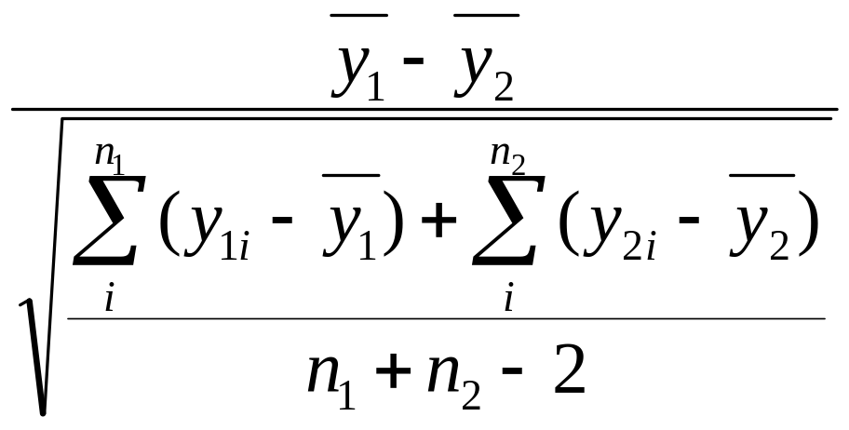
Statistical Significance and the Effect Size
Statistical Significance = Effect Size (ES) X Sample Size
ES =

Slide 74
Hypothesis Testing Flow Chart
Develop research hypothesis & null hypothesis
Set alpha (usually .05)
Calculate power to determine the sample size
Collect data & calculate statistic and p
P < .05
Compare p to alpha (.05)
P > .05
Reject null hypothesis
Fail to reject null hypothesis

